Slide 1
Weekly Work Update
Image To Words – 13th November
Horatiu Ilie

Slide 2
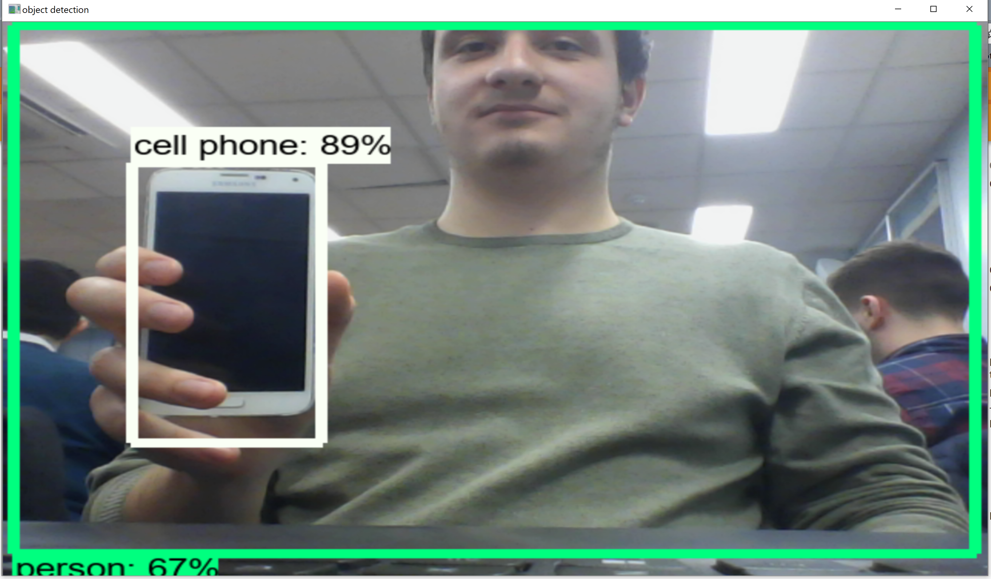
Tensorflow API Integration
Object Detection Python API
Pre-trained model
Model can be further trained
WebCam Windows App using OpenCV
Next iteration: implement in Java for Android

Slide 3
Future Datasets to Consider
NYU Depth V1 / V2
https://cs.nyu.edu/home/index.html
COCO
http://cocodataset.org/#home
VOC Pascal 101 (unlabeled)
http://host.robots.ox.ac.uk/pascal/VOC/databases.html#101
Pascal VOC 2005
http://host.robots.ox.ac.uk/pascal/VOC/databases.html#VOC2005_1
CIFAR-10 & CIFAR-100
https://www.cs.toronto.edu/~kriz/cifar.html

Slide 4
Project Plan - Draft
Created first project plan
Used guidelines on Moodle
To be discussed / agreed on soon
To submit on Wednesday, 15th Novemeber

